Slide 1
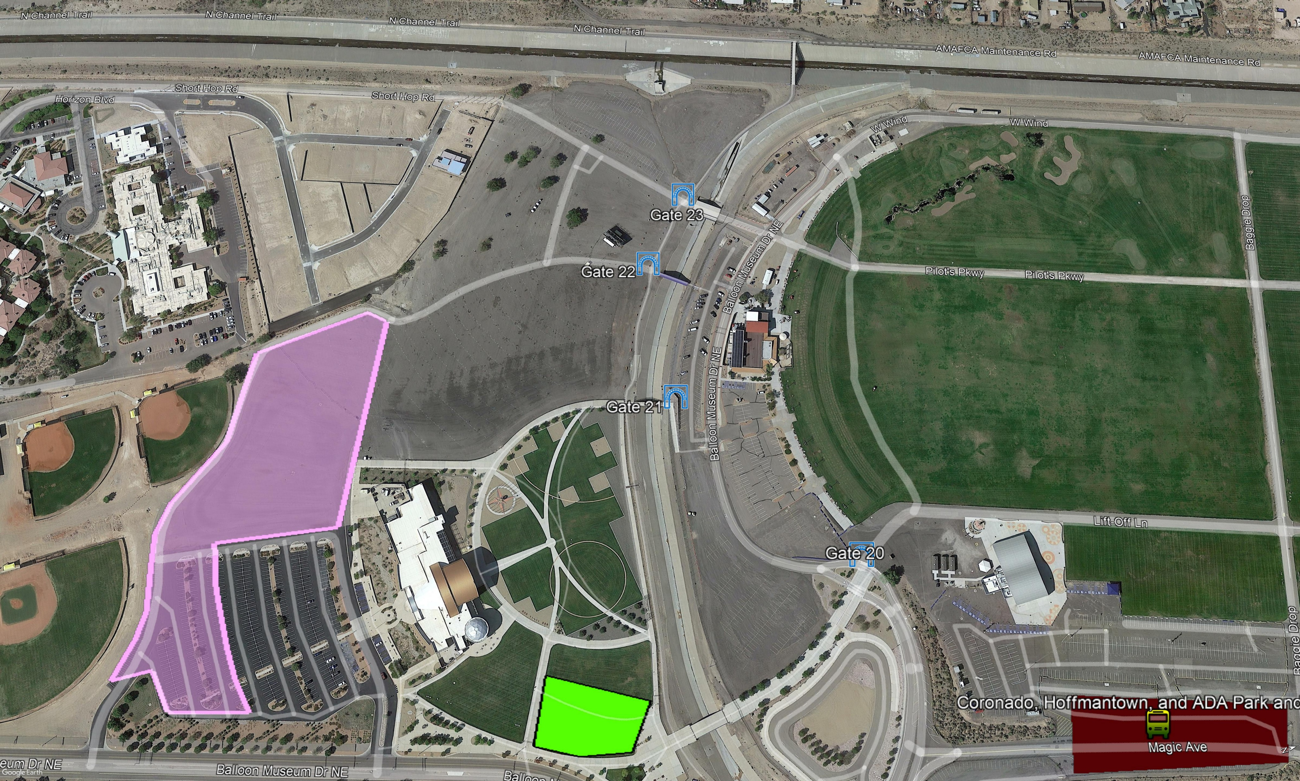
Access to the Diversion Channel trail begin south of Alameda Blvd, and east of Edith.
LAUNCH FIELD
Bike
Valet
Entrance

